Slide 1
Assignment – 2
ACADEMIC SESSION 2020/2021
DR PROF MADYA DR. NURUL HASHIMAH AHAMED HASSAIN MALIM
CPT111
ANJUMANARA ATHINA
Matric No: 155142

Slide 2
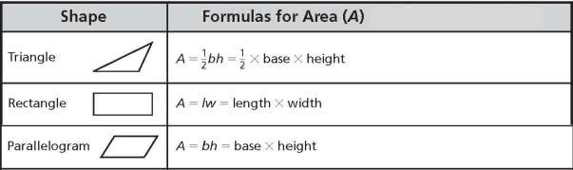
Topic:Learning About Areas of Shapes

Slide 3
1. Problem Analysis
(Input, Output, Process and Constraints)
2. Algorithm (Pseudocode OR Flow Chart)
4. Test cases (Screenshots for the test cases)
3. Implementation (C++ Program)

Slide 4
1.Problem Analysis
(Input, Output, Process and Constraints)

Slide 5
Input :
Enter any 6 digit ID
choose an option from the menu( Test Yourself with
Quiz based on specific shape, Area of Shapes)
choose either you try again or you exit
exit option

Slide 6
Process :
Determine to display hight, area and base of three different shapes and reversely calculate values of height or width or base.Using these formulas-
Triangle :area= (base*height)/2
base=(area*2)/height;
height=(area*2)/base;
Rectangle :area= length * width
length=area / width
width=area / length;
Parallelogram :area= base * height
base=area/height
Height=area/base;
totalmark=totalmark + mark
percentage:(totalmark/12)*100 << "%

Slide 7
Output :
Give the quizzes , checking the answers ,showing the total mark in percentage and if wrong then showing the correct answer.

Slide 8
Constraints :
You can only choose one of the two program.
In second program you can choose one shape from three shape.
You can either try again or exit .
You can not have more then 12 questions for the quiz program (there are 12 rows, 3 columns)

Slide 9
2. Algorithm (Pseudocode)

Slide 10
Pseudocode :
Give the 6 digit student id to enter
Write the definition and the two program options.
When user chooses an option, display the program that user has chosen.
Create the three options: Test Yourself with Quiz based on specific shape, Area of Shapes,exit.

Slide 11
When the user choose the Test Yourself with Quiz based on specific shape display the three shapes name to choose one from three.
When the user select any one shape give 12 quizes questions for each shape.
for every true answer give 1 marks and null for the wrong one and display the correct answer.

Slide 12
calculate and display the total score and the percentage.
When the user choose the Area of Shapes display the three shapes area formulas and give hight or area or base
Display the answer
Display reversely calculate values of height or width or base of the shape.

Slide 13
3.Implementation(C++ Program)
Refer to athina.cpp

Slide 14
4. Test cases (Screenshots for the test cases)

Slide 15
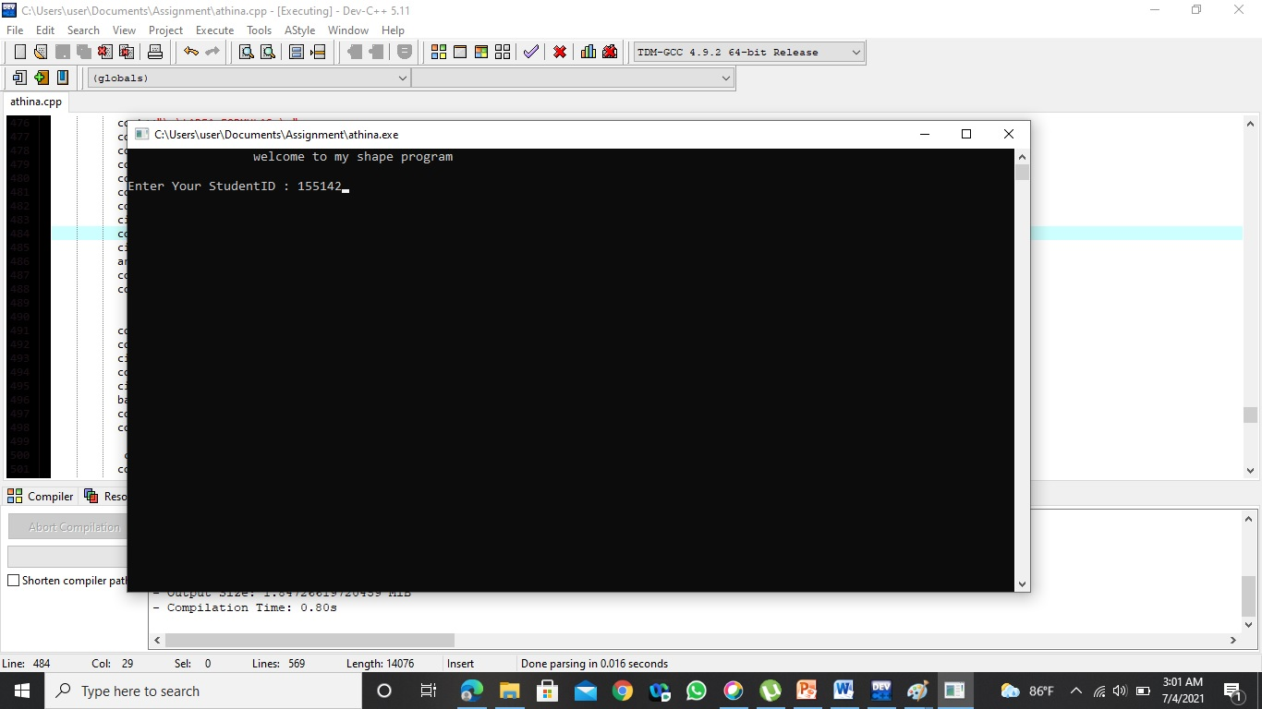

Slide 16
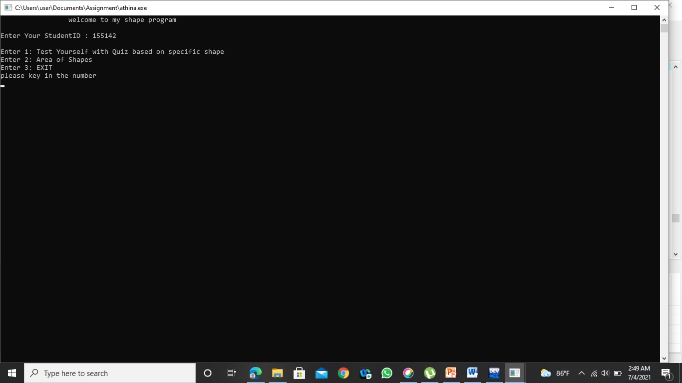
Main Menu

Slide 17
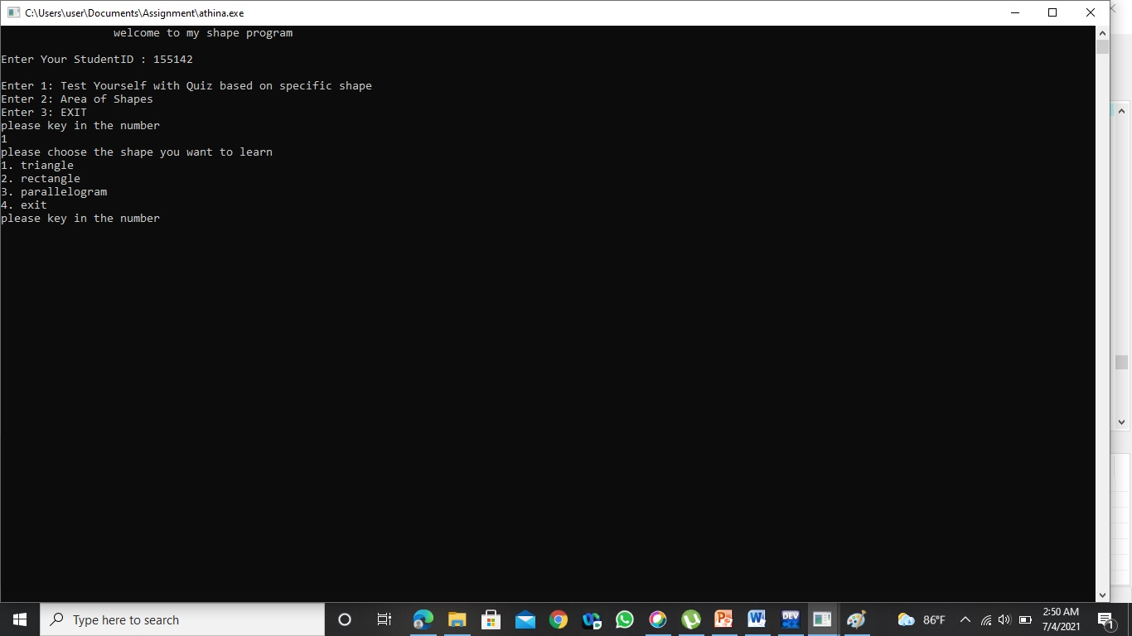

Slide 18
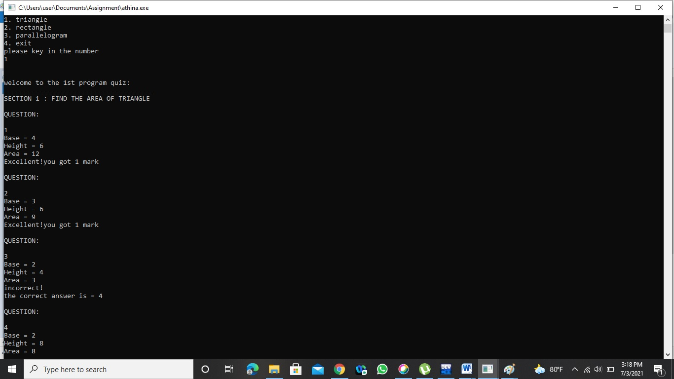

Slide 19


Slide 20


Slide 21


Slide 22


Slide 23


Slide 24


Slide 25


Slide 26
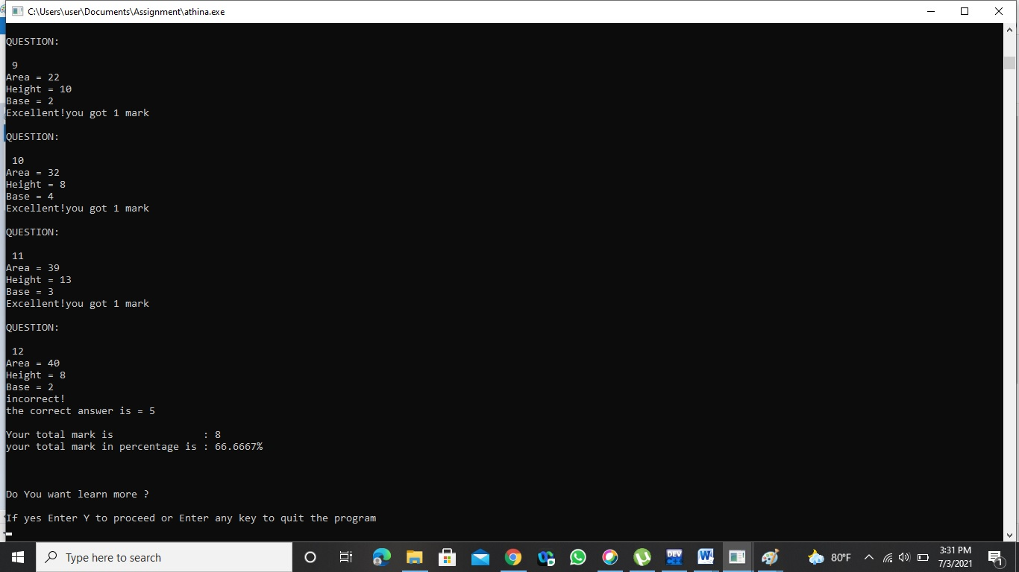

Slide 27
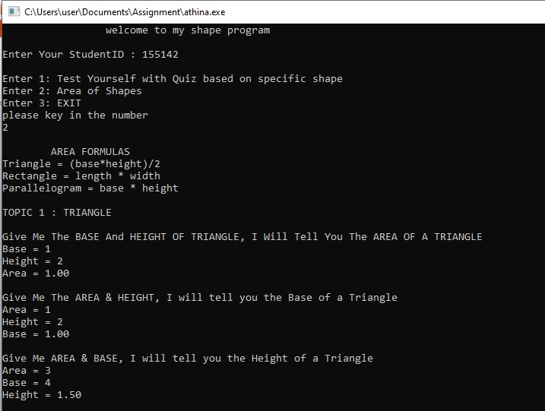

Slide 28
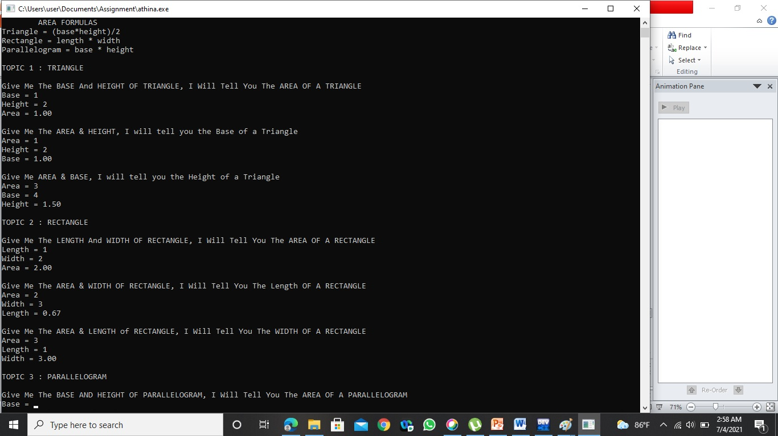

Slide 29
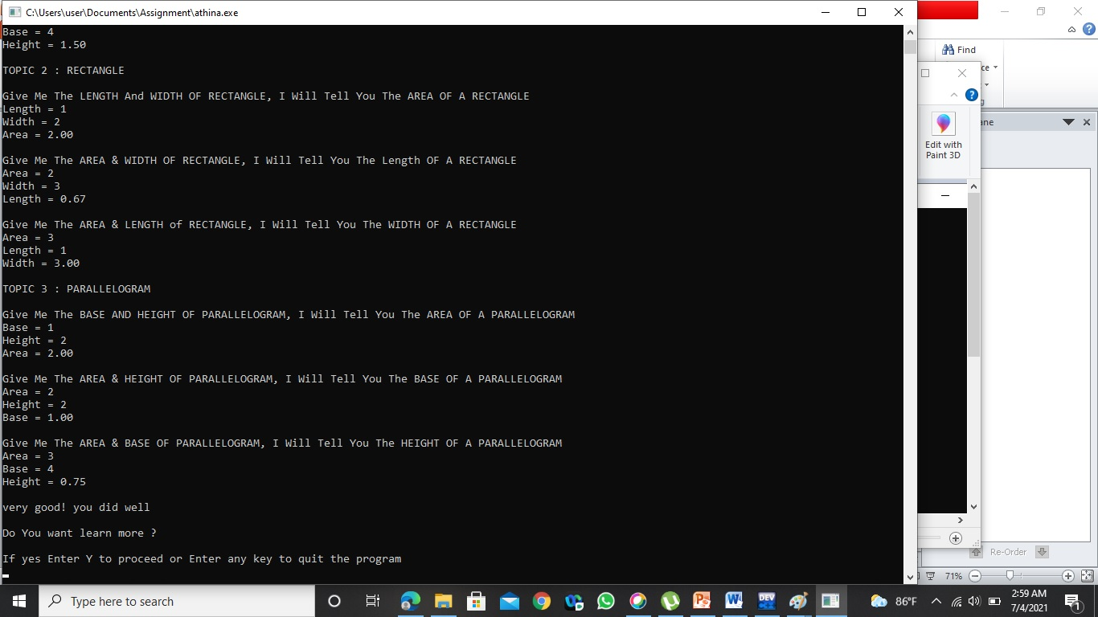

Slide 30
Thank You! a.athina2001@usm.my

